Slide 1


Slide 2
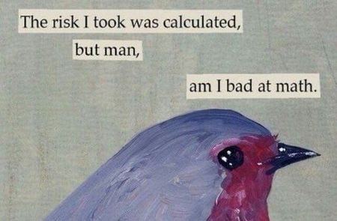

Slide 3


Slide 4
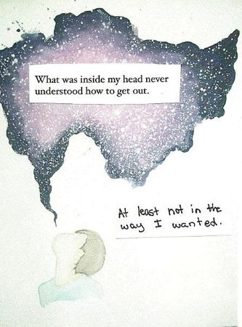

Slide 5
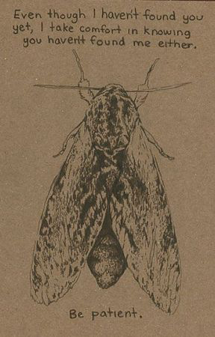

Slide 6


Slide 7
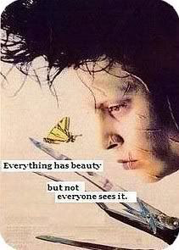

Slide 8
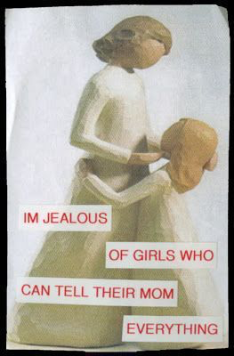

Slide 9
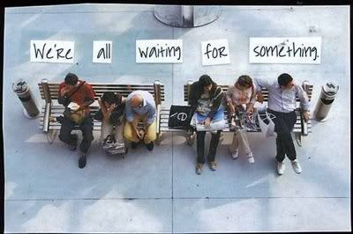

Slide 10
Check out the postsecret website to see more examples.

Slide 11
Secrets
We will "share" a secret "secretly" with the class. Using design elements, lettering, materials and empathy we will design a piece of art that illustrates, demonstrates and/or breathes life into someone else's secret.

Slide 12
YOUR SECRET
Think about your secret and what you want to share anonymously. The artist WON’T know whose secret it is unless you tell them.
Write it on the slip of paper carefully so another person can read it.
Put it into the box.
Tomorrow you will get a secret to begin designing.

Slide 13
Design Elements
Using the Principles of Design (Balance, Contrast, Emphasis, Movement, Pattern, Rhythm, Unity) within the artwork to create an engaging composition.

Slide 14
Lettering
The use of interesting fonts, weight within letters, word placement help a design piece.

Slide 15
Material Choices
Materials must be chosen well in order to express someone else’s thoughts.

Slide 16
Craftsmanship
the quality of design and work shown in something made by hand
You want this to be done well! It’s someone else’s secret!

Slide 17


Slide 18
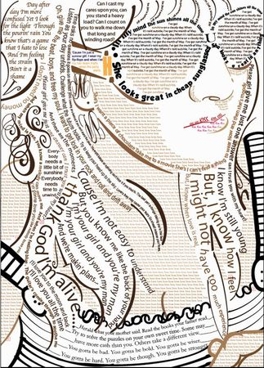

Slide 19
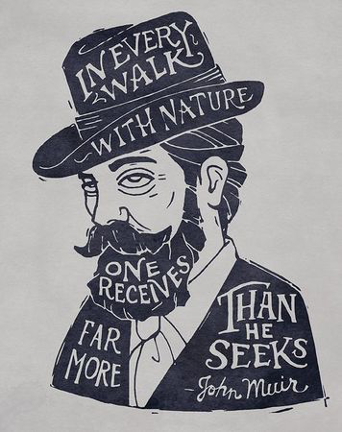

Slide 20


Slide 21


Slide 22


Slide 23
Lettering Examples

Slide 24
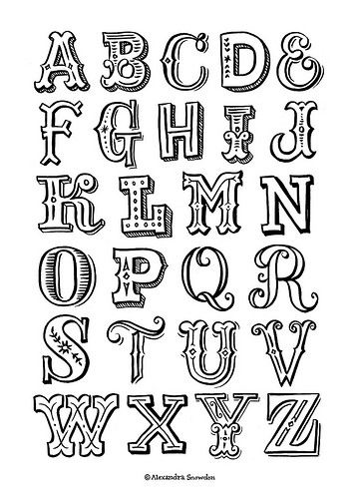

Slide 25
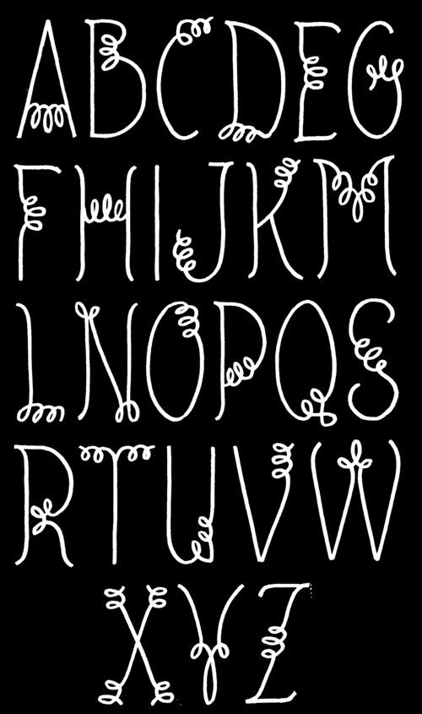

Slide 26
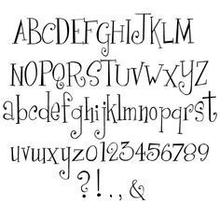

Slide 27
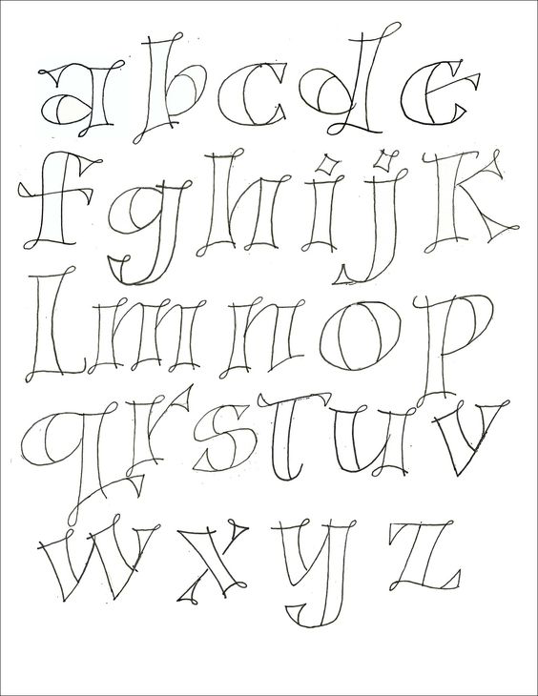

Slide 28
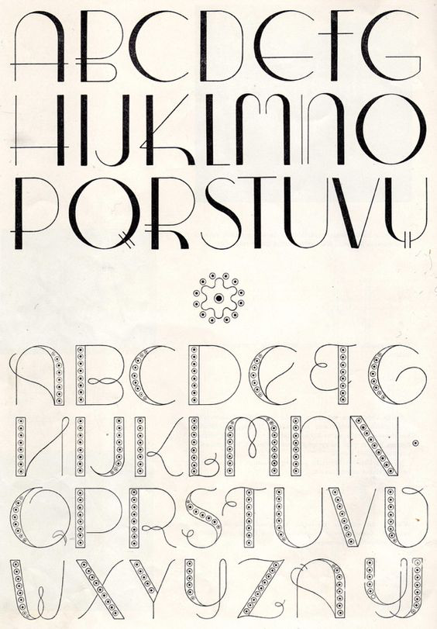

Slide 29
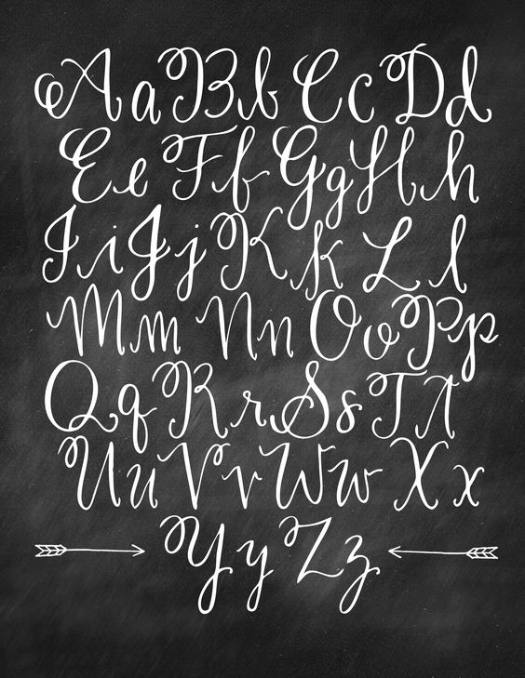

Slide 30
Check out the website for more ideas for lettering!
And videos!

Slide 31
Sketch and practice your lettering first.
Then decide on images, patterns, composition!
This is due October 5 at the beginning of class.

